Slide 1


Babies know words, even when they're mispronounced: A meta-analysis of mispronunciation sensitivity studies
Katie Von Holzen¹ &
Christina Bergmann²
1. TU Dortmund, Germany
2. Max Planck Institute for Psycholinguistics, The Netherlands

Slide 2



Babies know words, even when they're mispronounced: A meta-analysis of mispronunciation sensitivity studies
Katie Von Holzen¹ &
Christina Bergmann²
1. TU Dortmund, Germany
2. Max Planck Institute for Psycholinguistics, The Netherlands

Slide 3
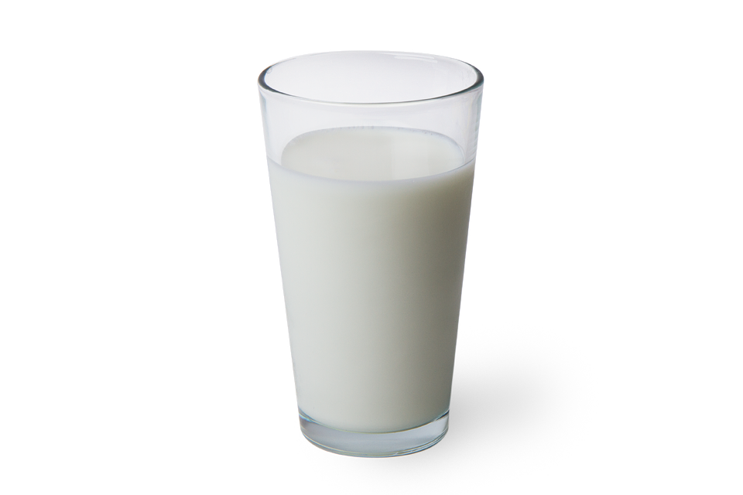

Slide 4

Milk
/mɪlk/

Slide 5

Milk
/mɪlk/
Milk
/mɛlk/
Notes:
Phonemic difference
But, we can cope with this regional variation and know that I am still referring to the same thing, despite my regional pronunciation

Slide 6

Milk
/mɪlk/
Milk
/mɛlk/
Mulk
/mʌlk/
Bilk
/bɪlk/
Notes:
In comparison, of course, calling this drink “bilk” is not acceptable.

Slide 7

Notes:
But we’re all adults here and we have acquired the phonetic categories that make up our native language

Slide 8
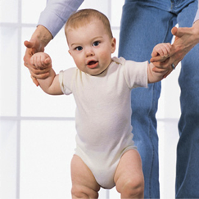
Notes:
But how do babies do this?
Need to know where variation in words does not actually indicate a new word, as in MELK.
Must also reject variation when the it potentially alters the meaning of the word, as in BILK.
When I talk about mispronunciation sensitivity, I’m talking about this latter point.

Slide 9
Milk
/mɪlk/
Bilk
/bɪlk/
Notes:
When I talk about mispronunciation sensitivity, I’m talking about this latter point. Being sensitive to sound changes in familiar words.
By studying mispronunciation sensitivity in infants, we’re looking at whether they’ve formed fully specified phonological representations for familiar words

Slide 10
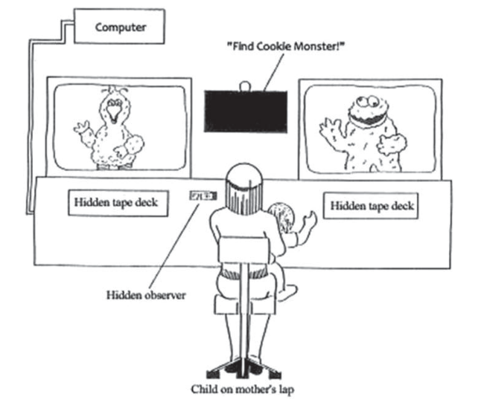
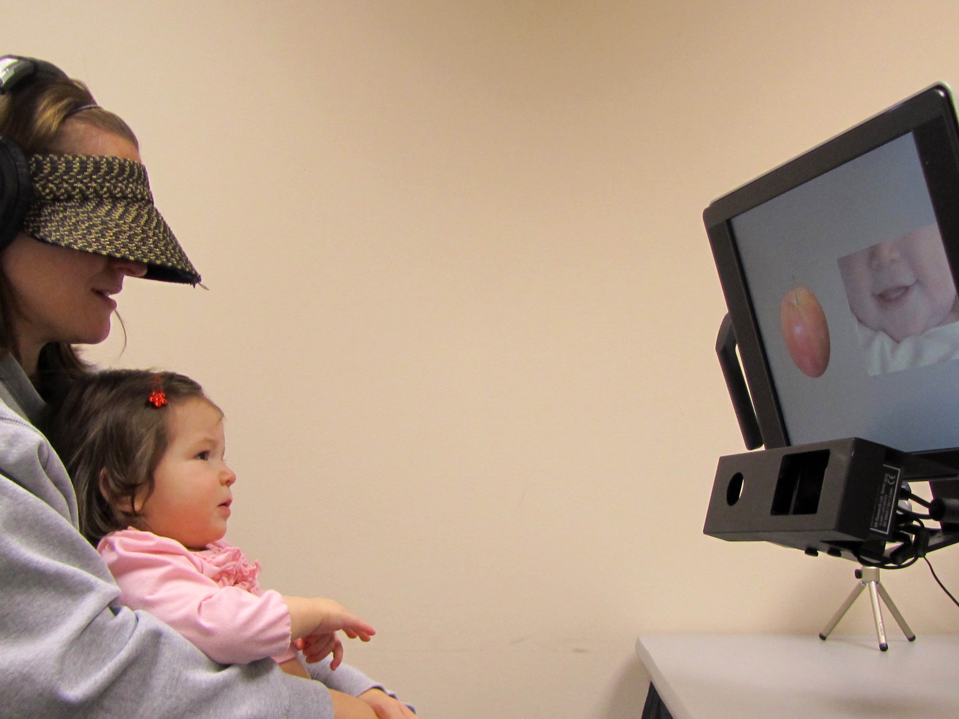
Golinkoff, Hirsh-Pasek,
Cauley, & Gordon, 1987
Bergelson Lab, Duke University
Notes:
But how do we test this? Using the Intermodal Preferential Looking Paradigm.

Slide 11
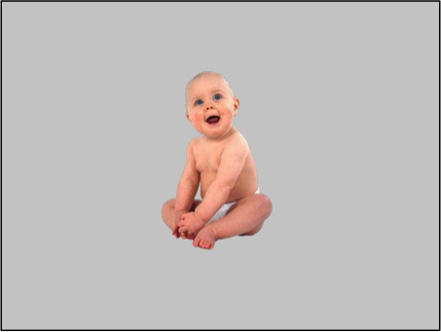
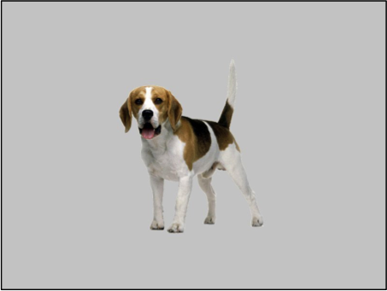
Swingley & Aslin, 2000
Notes:
The first ever mispronunciation sensitivity study with infants was by Swingley & Aslin in 2000. Describe what they did

Slide 12

Swingley & Aslin, 2000

Slide 13
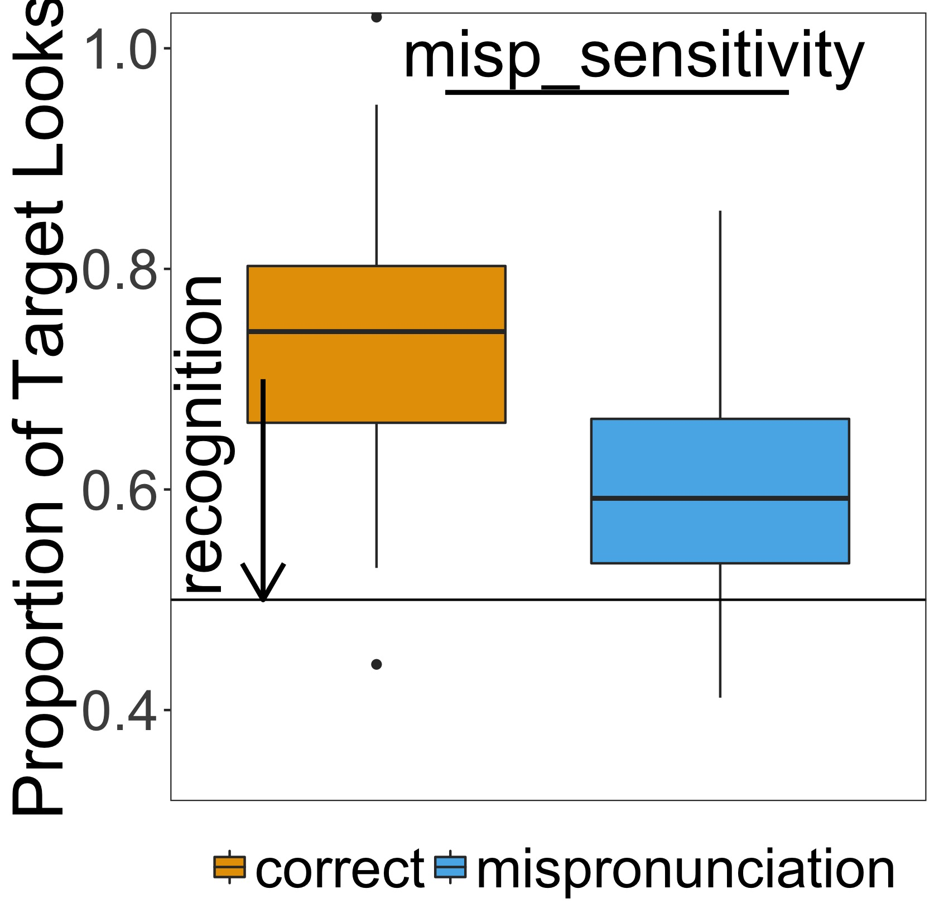
Swingley & Aslin, 2000

Slide 14

Swingley & Aslin, 2000

Slide 15
Swingley & Aslin, 2000

Slide 16
sensitivity to a small, but potentially meaning-altering change in the acoustic word form
Swingley & Aslin, 2000

Slide 17
sensitivity to a small, but potentially meaning-altering change in the acoustic word form
18-23-month-olds have phonologically well specified representations for familiar words
Swingley & Aslin, 2000

Slide 18
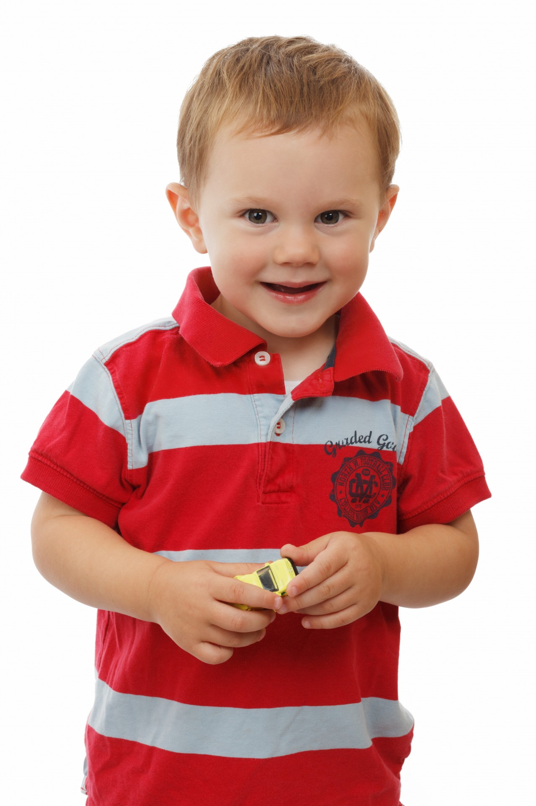
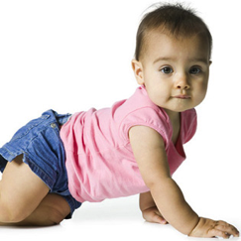
Notes:
Christina and I were interested in the developmental trajectory of mispronunciation sensitivity.
When we turned to the literature, we actually found support for all different kinds of developmental trajectories

Slide 19
Mispronunciation sensitivity
Time

Slide 20
apple
dog
milk
baby
Mispronunciation sensitivity
Time

Slide 21
apple
dog
milk
baby
Mispronunciation sensitivity
Time

Slide 22
apple
dog
milk
baby
Mispronunciation sensitivity
Time
Theory 1: Mispronunciation sensitivity increases over time
From holistic to more detailed representations
Altvater-Mackensen & Mani, 2013; Mani & Plunkett, 2007; van der Feest & Fikkert, 2015

Slide 23
apple
dog
milk
baby
Mispronunciation sensitivity
Time
Theory 2: Mispronunciation sensitivity stays the same over time
Early specificity
Swingley & Aslin, 2000; Bailey & Plunkett, 2002; Zesiger et al., 2012

Slide 24
apple
dog
milk
baby
Mispronunciation sensitivity
Time
Theory 3: Mispronunciation sensitivity decreases over time
Mani & Plunkett, 2011

Slide 25
Increase
Decrease
Stays same
Mispronunciation Sensitivity
Age
Altvater-Mackensen & Mani, 2013; Mani & Plunkett, 2007; van der Feest & Fikkert, 2015
Mani & Plunkett, 2011
Swingley & Aslin, 2000; Bailey & Plunkett, 2002; Zesiger et al., 2012
Notes:
So, there are experimental results supporting several different developmental trajectories
This is the kind of situation that is ripe for a meta-analysis, to aggregate the existing evidence together to try to uncover the true effect
For example, maybe the variation in the results is because the studies are underpowered. Its likely that in our field, infancy research, we don’t test enough babies to actually detect the effects we’re looking for (click ahead for power slides)

Slide 26
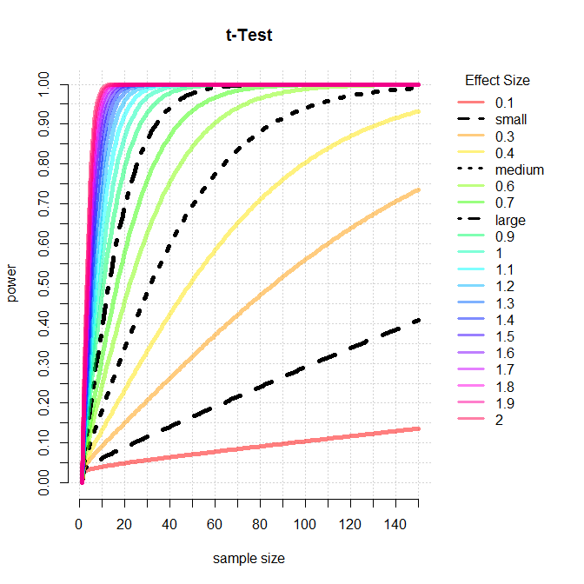
Notes:
The power of a study is the likelihood that it will distinguish an effect of a certain size from pure luck. If a study is underpowered, our chances of making the wrong conclusions from the data increase.
Power has a direct relationship with sample size. The larger our sample size, the more likely we are to be able to detect the effect that we’re looking for.

Slide 27
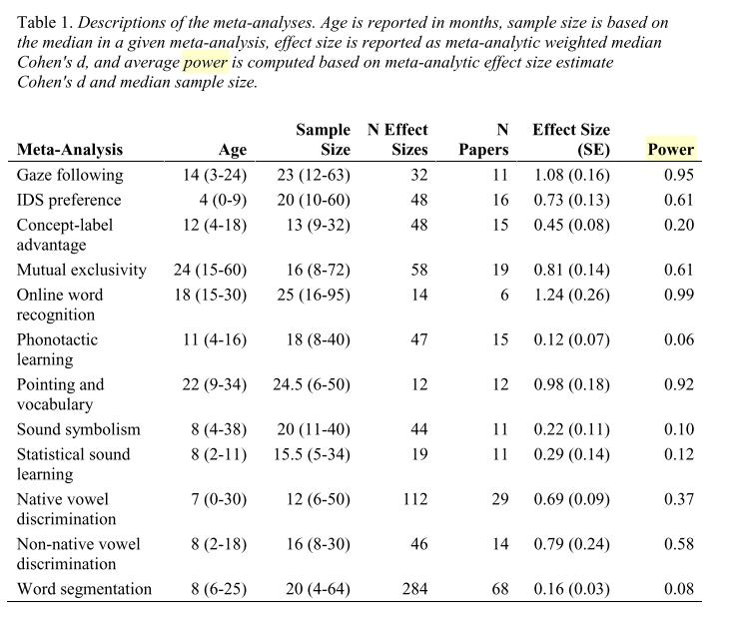
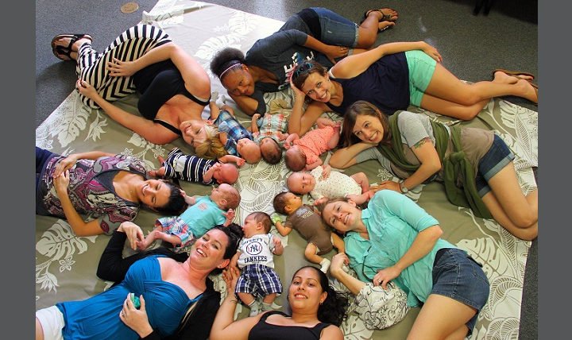
Bergmann et al., 2018, Child Development
Notes:
Testing babies in a laboratory is time consuming and expensive. As a result, many developmental studies are underpowered.

Slide 28
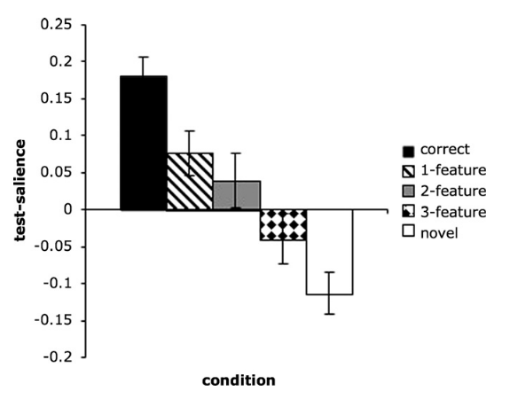
White & Morgan, 2008
Notes:
Another possible explanation is that mispronunciation studies are not only looking at phonological specificity, but also additional things, like the number of phonological features changed, to see whether like adults, infants show graded sensitivity to the degree of mismatch in mispronounced words

Slide 29
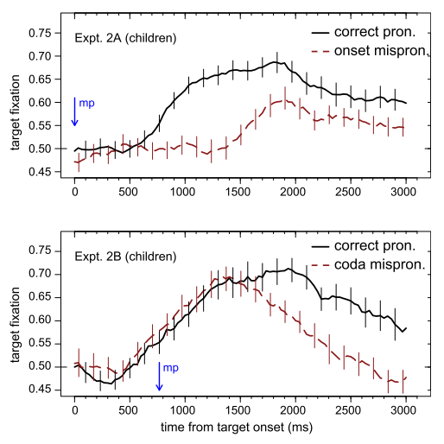
White & Morgan, 2008
Swingley, 2009
Notes:
Or, whether the position of the mispronunciation in the word matters. Different theories of word recognition put different emphases on phoneme position. The COHORT model would place more importance on phonemes in earlier positions in a word, sensitivity to a mispronunciation on the onset of the word would be more disruptive than a coda mispronunciation

Slide 30
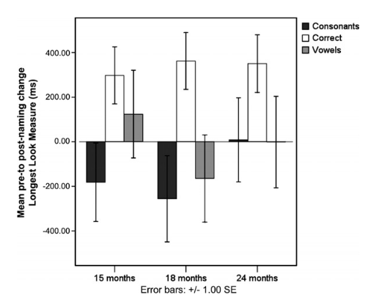
White & Morgan, 2008
Mani & Plunkett, 2007
Swingley, 2009
Notes:
Other studies compare sensitivity to consonant and vowel mispronunciations. If you’re familiar with Thierry’s groundbreaking work in this area, or the work I did while in this lab, then you’ll know which this is particularly interesting. The idea here is that consonants carry the weight of lexical processing and we see in adults that they are more sensitive to consonant changes or particularly use this information when recognizing words

Slide 31
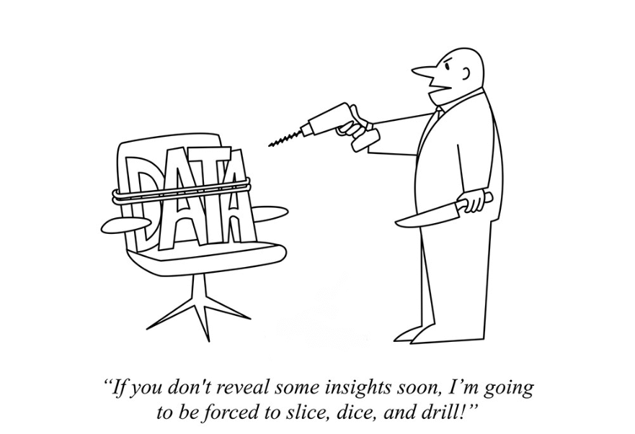
Notes:
And finally, and this is doing a bit of foreshadowing, there is quite a bit of variation in how mispronunciation sensitivity studies are analyzed. I’ll show you what I mean later

Slide 32
Data Sample
Screened over 400 papers
Original data
Infants younger than 31 months
Familiar word recognition
Measured eye movements

Slide 33
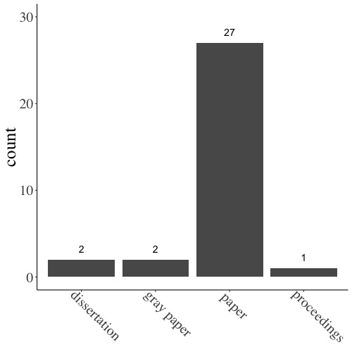
Data Sample
Screened over 400 papers
Original data
Infants younger than 31 months
Familiar word recognition
Measured eye movements
Final sample: 32 items
249 experimental conditions
2252 infants

Slide 34
Effect Size calculation
Hedges’ g

Slide 35
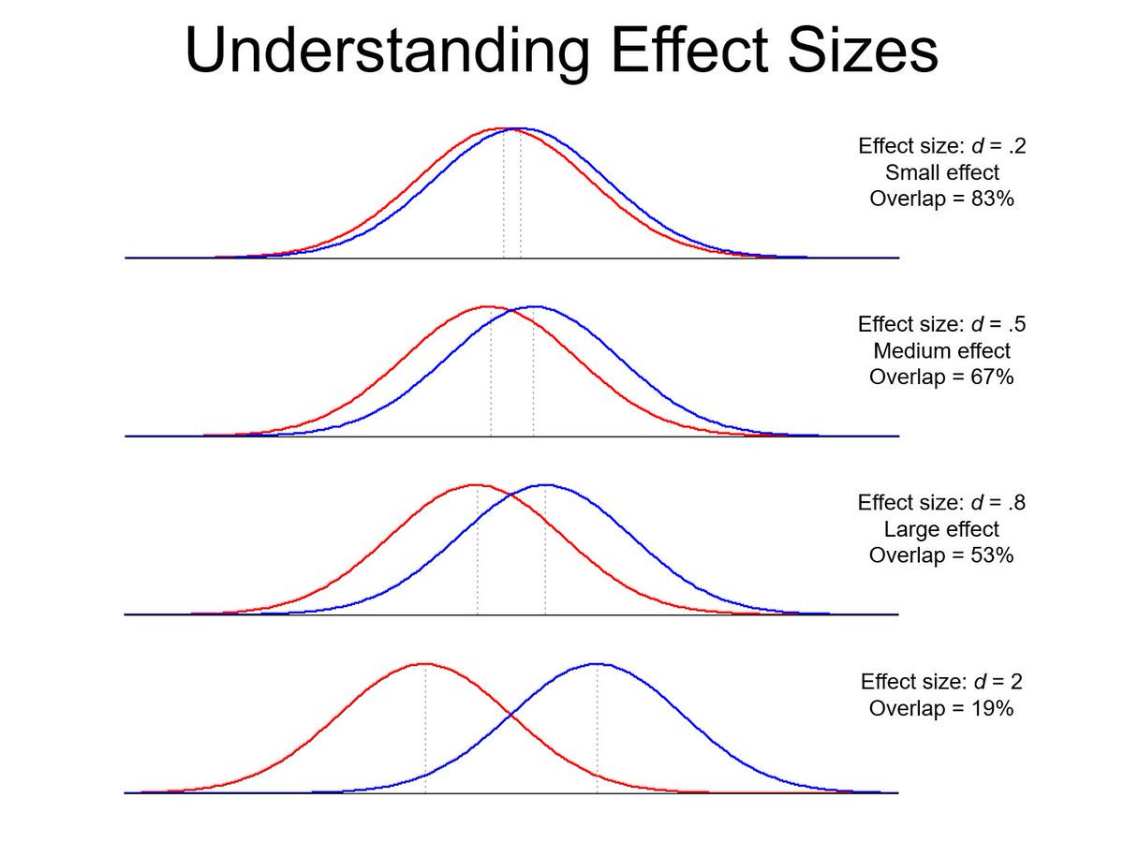
Notes:
Effect sizes are the standard mean difference between two conditions. They’re a way of representing just how big the difference between two conditions are, in a way that is standardized.

Slide 36
Effect Size calculation
Hedges’ g
Hedges, 1981; Morris, 2000
Effect size that corrects for small sample sizes
Based on raw data (mean & sd) or test statistics reported in paper

Slide 37
Development of Mispronunciation Sensitivity
Theories invoking developmental change relate it to vocabulary growth

Slide 38
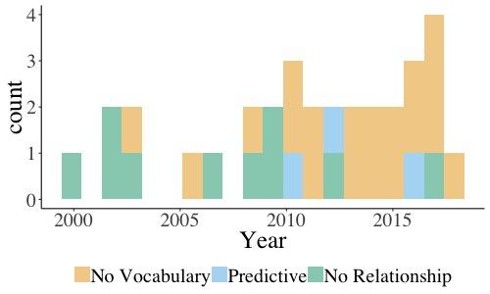
Development of Mispronunciation Sensitivity
Theories invoking developmental change relate it to vocabulary growth
Yet, few studies reported vocabulary
19 no vocabulary
3 find relationship
10 no relationship

Slide 39
Development of Mispronunciation Sensitivity
Theories invoking developmental change relate it to vocabulary growth
Yet, few studies reported vocabulary
19 no vocabulary
3 find relationship
10 no relationship
→ Use age as a moderator

Slide 40
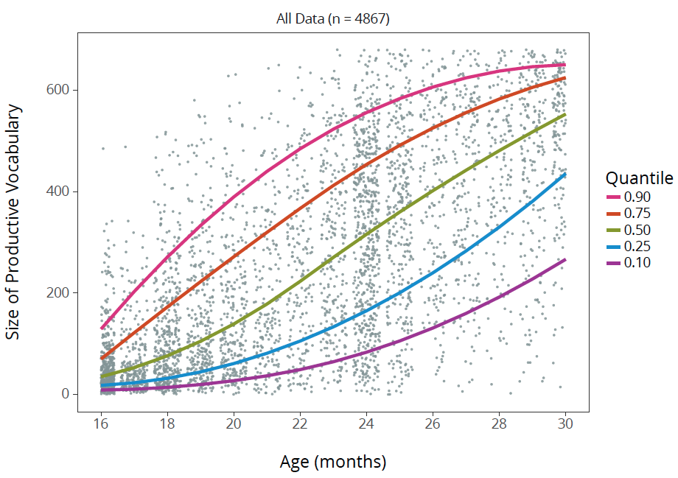
Frank et al., 2016; retrieved 7/6/18 from http://wordbank.stanford.edu

Slide 41
Swingley & Aslin, 2000
Notes:
Just as a reminder...

Slide 42
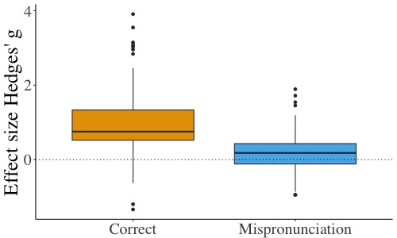
Object Identification / Recognition
Effect sizes above chance
Notes:
Now we’re measuring using effect size Hedges’ g
But still, if the effect size is above 0, we can conclude that children are associating the target image with that pronunciation

Slide 43
Object Identification / Recognition
Effect sizes above chance
Correct Pronunciation
g = 0.91
95% CI [0.63, 1.14]
(SE = 0.12, p < .0001)

Slide 44
Object Identification / Recognition
Effect sizes above chance
Correct Pronunciation
g = 0.91
95% CI [0.63, 1.14]
(SE = 0.12, p < .0001)
Mispronunciation
g = 0.25
95% CI [0.13, 0.37]
SE = 0.06, p < .0001

Slide 45
Mispronunciation Sensitivity
Effect sizes different between correct and mispronunciation
Notes:
so, although infants looked at the target image in response to the mispronunciation, this was reduced compared to the correct pronunciation

Slide 46
Mispronunciation Sensitivity
Effect sizes different between correct and mispronunciation
𝛽 = 0.5
95% CI [0.43, 0.56]
SE = 0.03, p < .0001
Notes:
so, although infants looked at the target image in response to the mispronunciation, this was reduced compared to the correct pronunciation

Slide 47
Developmental Change: Age Moderator
Increase
Decrease
Stays same
Mispronunciation Sensitivity
Age
Altvater-Mackensen & Mani, 2013; Mani & Plunkett, 2007; van der Feest & Fikkert, 2015
Mani & Plunkett, 2011
Swingley & Aslin, 2000; Bailey & Plunkett, 2002; Zesiger et al., 2012
Notes:
Having established a robust effect of mispronunciation sensitivity, we next turned to examine whether sensitivity changes with development and added age as a moderator to our model.

Slide 48
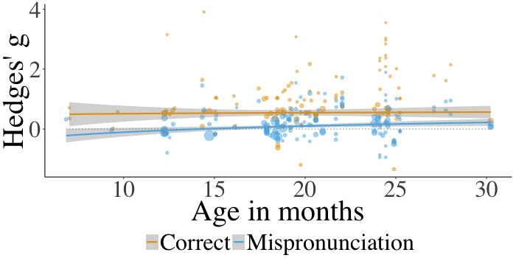
Notes:
Explain graph, remember to say each dot is an individual experimental condition
As you can see, the fit lines for correct pronunciations and mispronunciations are rather flat

Slide 49
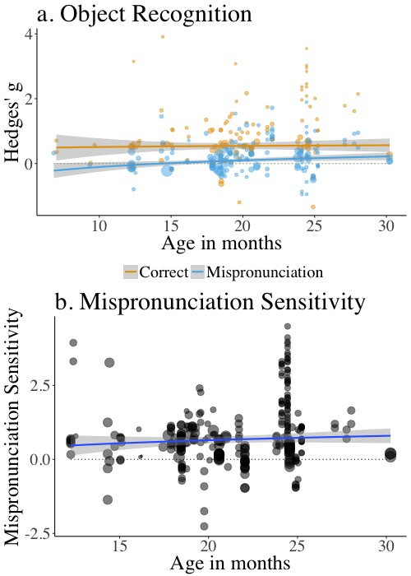
Notes:
We can look at this a different way. On the left is the graph you just saw and on the right is the within-experiment difference between correct pronunciations and mispronunciations. Here, it is even easier to see how flat the effect is.

Slide 50
Early specificity: Mispronunciation sensitivity stays the same with age
Notes:
The results of the model confirmed that pooling over all studies, mispronunciation sensitivity stays the same over development. This is something that we may not be able to observe if we are testing a couple age groups, but using a meta-analytic approach, we can be more confident in this conclusion and add it to our theoretical understanding.

Slide 51

Notes:
So, it appeared that mispronunciation sensitivity is similar across ages.

Slide 52

Notes:
Christina and I were pretty puzzled by this, considering that most theoretical developmental accounts propose some change over time.

Slide 53
Task Difficulty?
Notes:
One possibility that we considered was that the kind of task given to children changed, with older children given a more difficult task and younger children given an easier task. This could lead to a lack of developmental differences.

Slide 54

Task Difficulty?
Notes:
One possibility that we considered was that the kind of task given to children changed, with older children given a more difficult task and younger children given an easier task. This could lead to a lack of developmental differences.

Slide 55
Mispronunciation size: sensitivity to phonological features
White & Morgan, 2008
Notes:
One way to make the task easier or more difficult is to vary the size of the mispronunciation.
In my previous example, I used Dog and Tog.
This is a 1 feature change in manner.
All you need to know is that is a relatively small change in sound, from d to t.
We tested this prediction, which has been supported by previous studies.

Slide 56
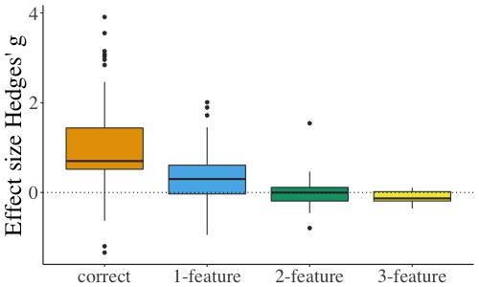
Mispronunciation size
White & Morgan, 2008

Slide 57
Mispronunciation size
As mispronunciation size increases, mispronunciation sensitivity increases
g = -0.31
95% CI [-0.36, -0.25]
SE = 0.03, p < .0001
Notes:
We found that as mispronunciation size increases, mispronunciation sensitivity increases. Specifically, with each change in number of features, effect size is reduced by .31

Slide 58
Mispronunciation size
As mispronunciation size increases, mispronunciation sensitivity increases
g = -0.31
95% CI [-0.36, -0.25]
SE = 0.03, p < .0001
Not moderated by age
White & Morgan, 2008
Mani & Plunkett, 2011
Notes:
This confirms previous findings, which is has both theoretical and practical implications. Infants are sensitive to how different the correct pronunciation and mispronunciation are from one another. This is an important piece of knowledge as well, if you are designing a study.

Slide 59
Mispronunciation position
Tog
Dok
Notes:
Furthermore, mispronunciations at different positions in the word could differentially interrupt lexical processing

Slide 60
Mispronunciation position
Tog
Dok
Swingley, 2009
Notes:
This is what was found by Swingley

Slide 61
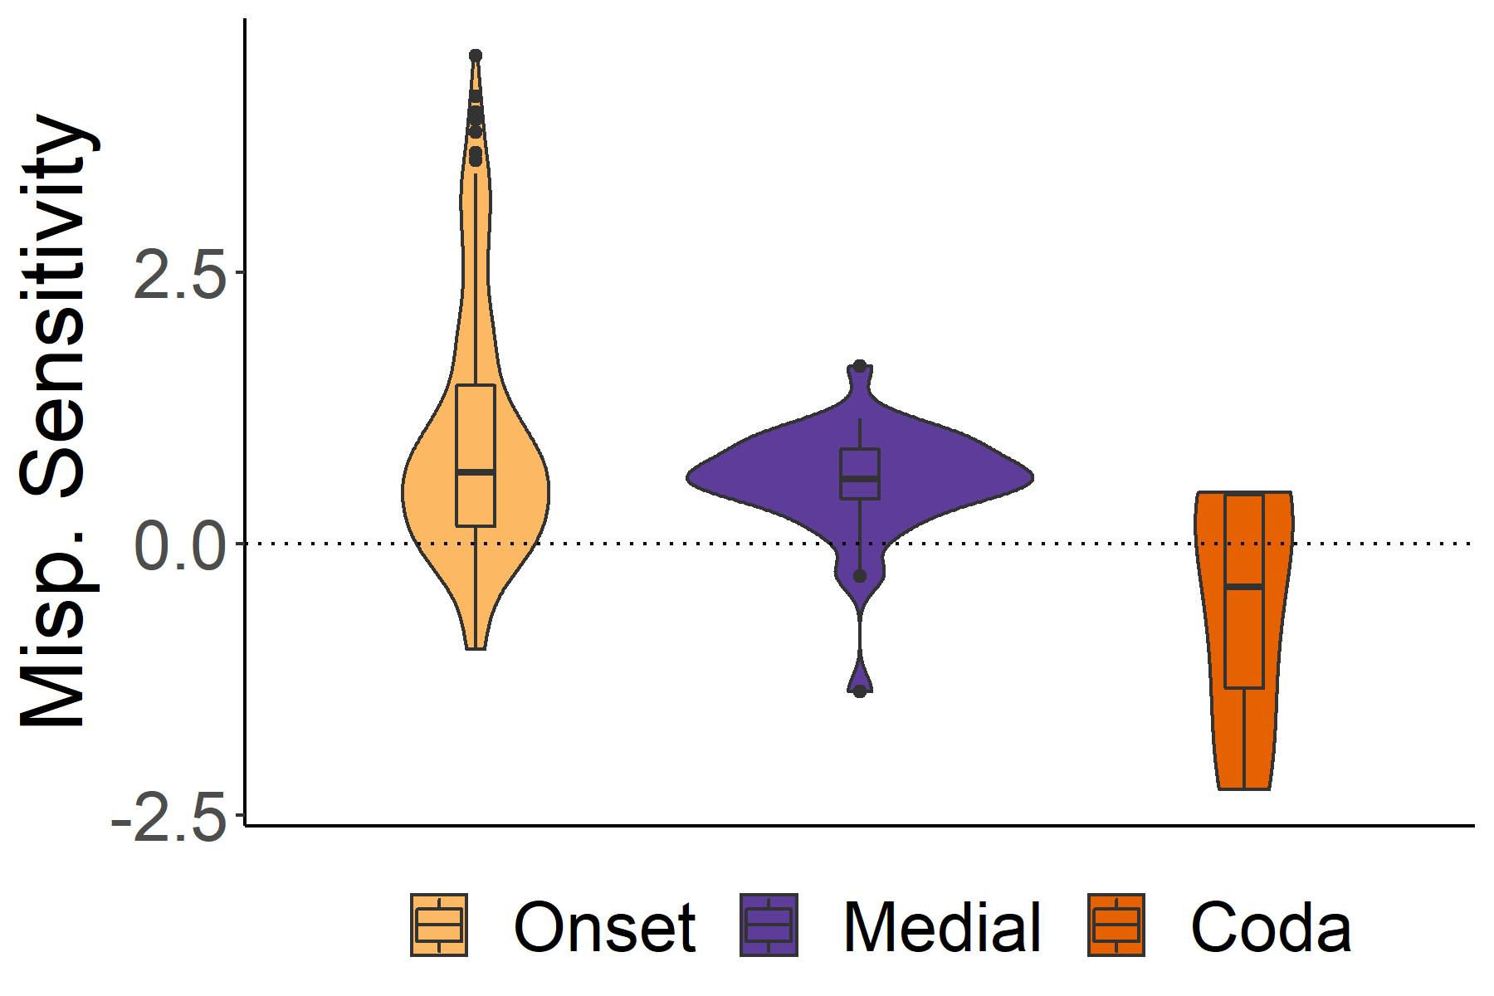
Mispronunciation position
White & Morgan, 2008
Mani & Plunkett, 2011
Notes:
So we examined whether the position of the mispronunciation modifies mispronunciation sensitivity

Slide 62
Mispronunciation position
As position of the mispronunciation move later in the word, mispronunciation sensitivity decreases
g = -0.15
95% CI [-0.27, -0.02]
SE = 0.06, p < .02
White & Morgan, 2008
Mani & Plunkett, 2011
Notes:
It does. As you move from onset to medial and then to coda mispronunciations, the drop in mispronunciation sensitivity is .15

Slide 63
Mispronunciation position
As position of the mispronunciation move later in the word, mispronunciation sensitivity decreases
g = -0.15
95% CI [-0.27, -0.02]
SE = 0.06, p < .02
Not moderated by age
White & Morgan, 2008
Mani & Plunkett, 2011
Notes:
Interestingly, this was also not moderated by age, so this finding was similar across the ages tested

Slide 64
Mispronunciation type: consonants vs. vowels
Mulk
/bʌlk/
Bilk
/bɪlk/
Notes:
As I mentioned previously, my work in this lab focused on the processing of consonants and vowels. The idea we were working on was that consonants are a cue to word identity. So, infants may be more sensitive to consonant than vowel mispronunciations. We tested this as well

Slide 65
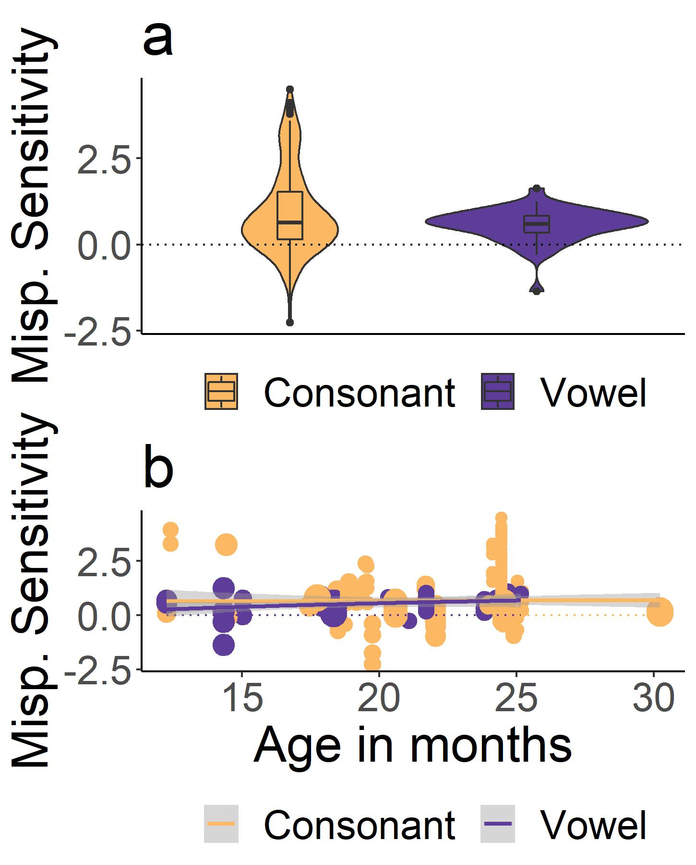
Mispronunciation type
No difference between consonant and vowel mispronunciations
g = -0.04
95% CI [-0.11, 0.2]
SE = 0.08, p = .58
Notes:
We find overall that there was no difference in sensitivity to consonants and vowels

Slide 66
Mispronunciation type
No difference between consonant and vowel mispronunciations
g = -0.04
Moderated by age
Sensitivity to vowels increases, consonants stays same
g = 0.04
95% CI [0.01, 0.08]
SE = 0.02, p < .03
Notes:
Interestingly, this was actually moderated by age. Although sensitivity to consonant mispronunciations stayed constant, sensitivity to vowel mispronunciations increased.

Slide 67
Mispronunciation type
No difference between consonant and vowel mispronunciations
g = -0.04
Moderated by age
Sensitivity to vowels increases, consonants stays same
g = 0.04
95% CI [0.01, 0.08]
SE = 0.02, p < .03
Notes:
Older infants were actually more likely to be tested on consonant mispronunciations, and younger infants on vowel mispronunciations
It would appear here that consonants have an initial advantage, but with time the importance of vowels grows

Slide 68
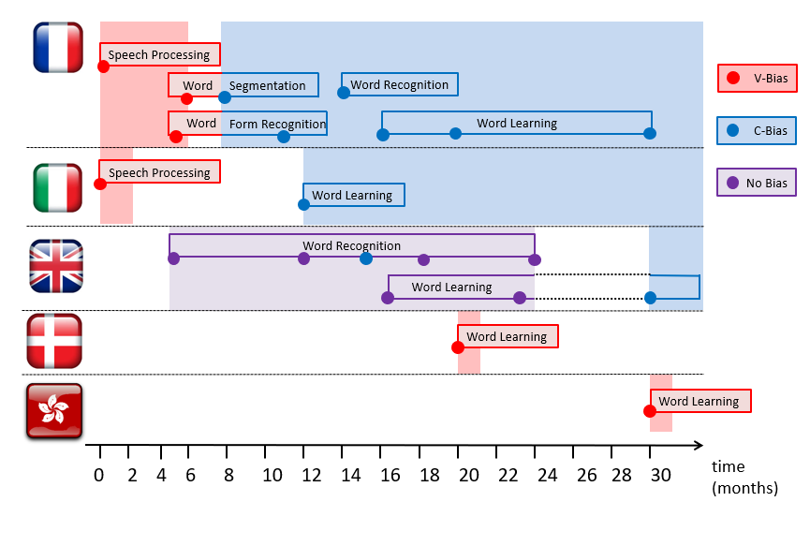
Adapted from Nazzi, Poltrock, & Von Holzen, 2016
Notes:
One thing that is important to know about this preference for consonants in lexical processing is that its emergence varies depending on the native language you are testing
This is an adaptation of a graph from one of our papers, updated since its already been 4 years since it was published.
As you can see…
So we found it theoretically motivating to look at the native language of the infants
But, we didn’t have enough data from each language, so instead we split the data into infants learning a Romance language and infants learning a Germanic language, as there appears to be differences along those lines

Slide 69
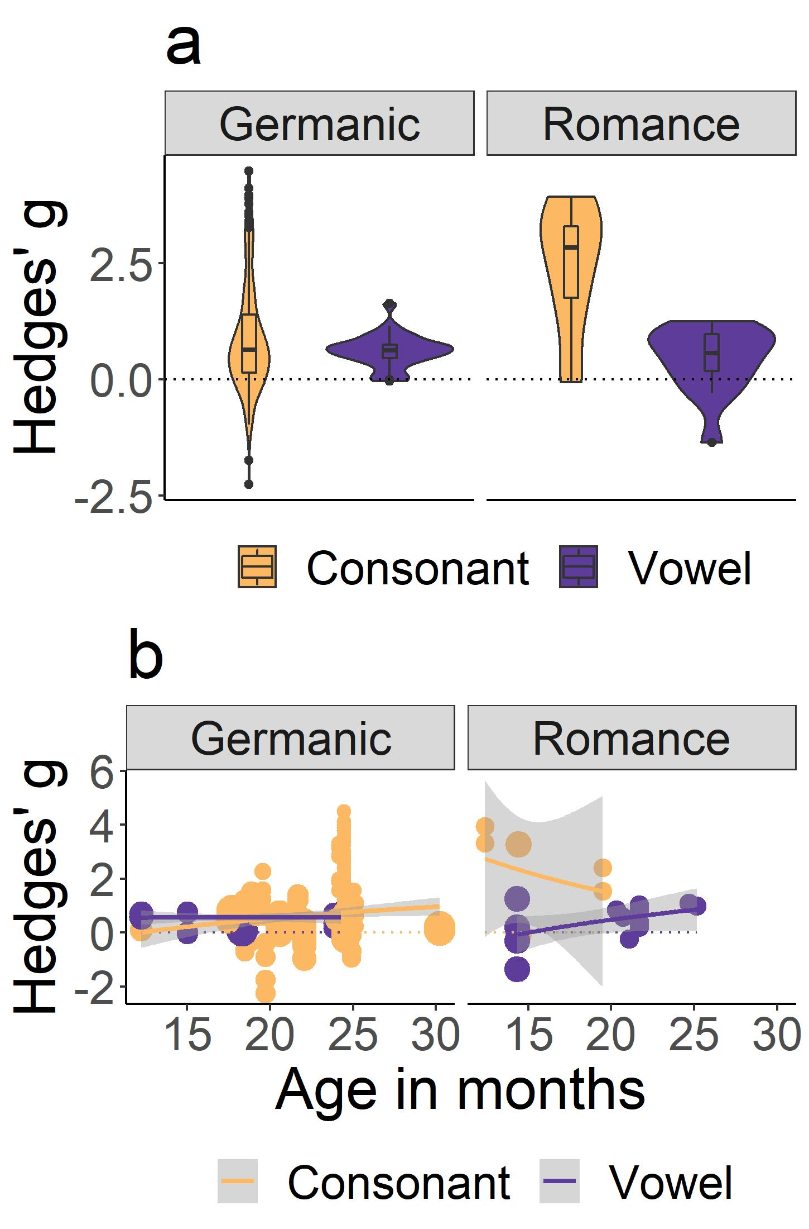
Mispronunciation type
Similar consonant mispronunciation sensitivity
Greater vowel sensitivity in Germanic languages
Notes:
We found similar sensitivity to consonants in both language families, but greater sensitivity to vowels in infants learning Germanic languages

Slide 70
Mispronunciation type
Similar consonant mispronunciation sensitivity
Greater vowel sensitivity in Germanic languages
Modulated by age
No difference for Germanic languages
Decrease for consonants, increase for vowels for Romance languages
Notes:
They also differed in their sensitivity by age
Unfortunately, there were much less studies on Romance languages, so take those results with a grain of salt

Slide 71
Adapted from Nazzi, Poltrock, & Von Holzen, 2016
Notes:
But, I think that this could support the general evidence in the field that there is no bias in English until a later age
But we see early sensitivity to consonants over vowels in children learning Romance languages

Slide 72
Notes:
So, although these analyses were quite interesting, reflecting and supporting what has been found previously in the field, they weren’t a great explanation for our lack of developmental effects.

Slide 73
Notes:
As I foreshadowed previously, we next considered how these studies are analyzed, which is a choice made by the authors

Slide 74
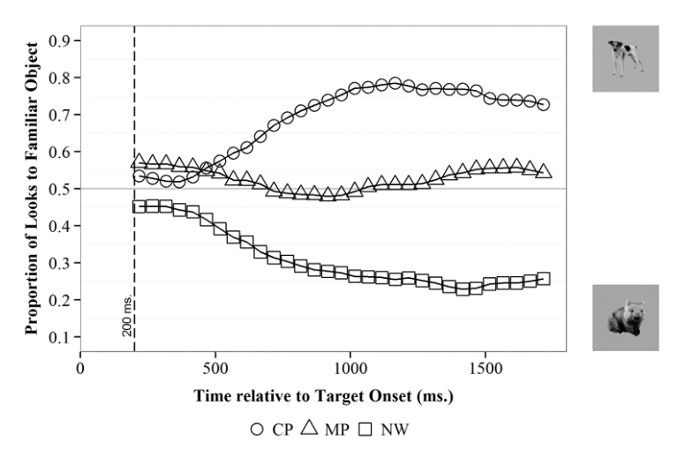
Adapted from Law & Edwards, 2015
Notes:
This is a graph of how eye-movements to the target image change over time. Over time, the looks to the target increase in response to a correct pronunciation, while they hover around chance in response to a mispronunciation

Slide 75
Adapted from Law & Edwards, 2015
Actual time presented
Notes:
When designing an experiment, researchers choose how long eye-movements will be measured after the target word has been presented.
This is baked into the experiment and I’ll try to refer to this as actual time presented.

Slide 76
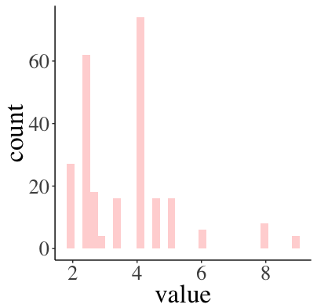
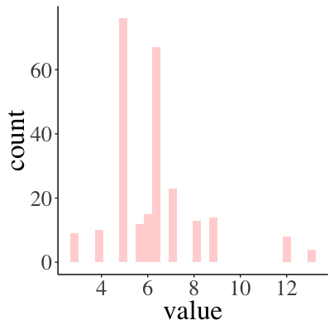
Actual post-naming window (s)
Notes:
There was quite a bit of variability in the length of actual time presented. One reason that researchers might vary this is that younger children take longer to look at the target image, so they might need a longer post-naming window.

Slide 77
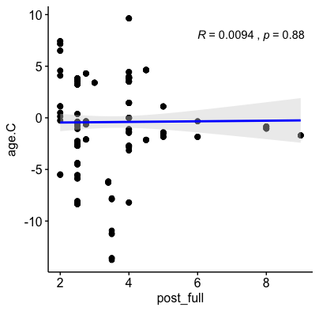
Actual post-naming window (s)
Notes:
But this was not the case. The actual time presented was not related to the age of infant tested.

Slide 78
Adapted from Law & Edwards, 2015
Actual time presented
≠
Analyzed time window
Notes:
We also found that often researchers shortened the amount of time that they used in their analysis. So for example, if the actual time presented was 2000 ms, the analyzed time window might be 1500 ms

Slide 79
Adapted from Law & Edwards, 2015
Actual time presented
≠
Analyzed time window
Actual time
=
Analyzed time
Notes:
I should point out that this was not the case for this particular study, which is why I’m using it as an example

Slide 80
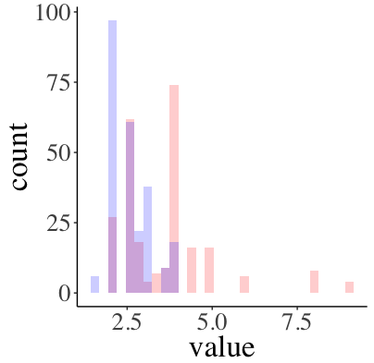
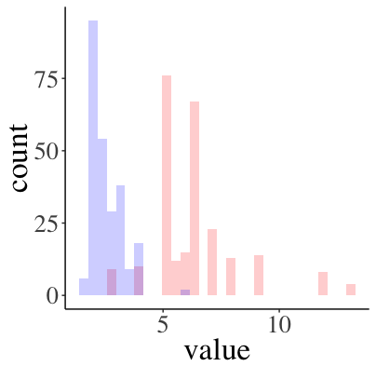
Post-naming phase window analyzed
Actual post-naming window (s)
Analyzed post-naming window (s)
Notes:
We found that a lot of studies were doing this. In pink is the data I showed you before, and in blue is how much of the trial was actually analyzed.

Slide 81
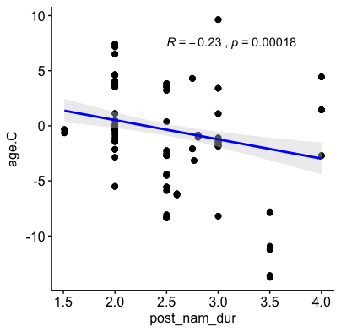
Post-naming phase window analyzed
Actual post-naming window (s)
Analyzed post-naming window (s)
Notes:
And this appeared to be influenced by age. The size of the analyzed window was longer for younger infants.
So, why would this matter?

Slide 82


Notes:
It means they’re boring the heck out of babies, and really for no reason!

Slide 83
Differences in analysis approach
Does the length of the analysis window influence whether the effect is found or not?
This is a choice that can happen after the data has been collected
Actual time presented
≠
Analyzed time window
Adapted from Law & Edwards, 2015

Slide 84
Differences in analysis approach
Does the length of the analysis window influence whether the effect is found or not?
This is a choice that can happen after the data has been collected
We’re not accusing anyone of misconduct!
Trying to determine what influence these choices may have
Influence on developmental change or lack thereof?

Slide 85
Post-naming phase window analyzed
Notes:
So what did we find?

Slide 86
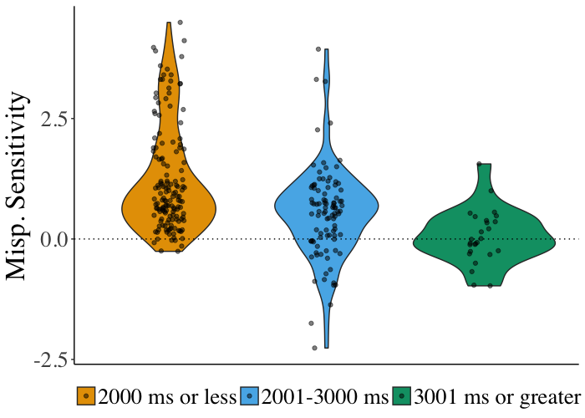
Post-naming phase window analyzed

Slide 87
Post-naming phase window analyzed
g = -0.26
SE = 0.06,
95% CI[-0.377, -0.148]
Related to mispronunciation sensitivity

Slide 88
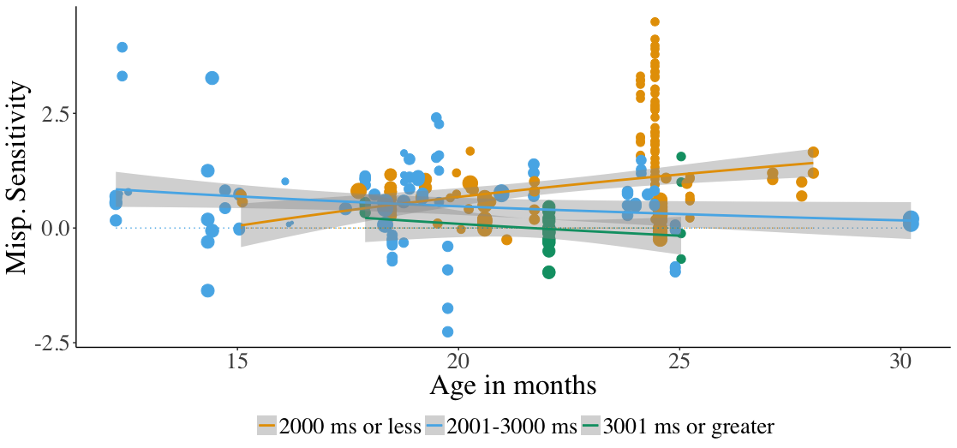
Post-naming phase window analyzed
Related to mispronunciation sensitivity development
Notes:
Furthermore, this had an influence on whether we would conclude that mispronunciation sensitivity changes with development. Studies using a smaller analysis window show us that it increases with development, but larger analysis windows may lead to the opposite conclusion.

Slide 89
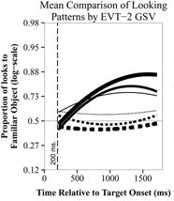
Influence of choices made for data analysis
Law & Edwards, 2015
Growth Curve Analysis
Mirman et al., 2008
Notes:
One way that future studies could combat this is by using an approach that takes change over time into account. One option is growth-curve analysis, which models the shape of change over time.

Slide 90
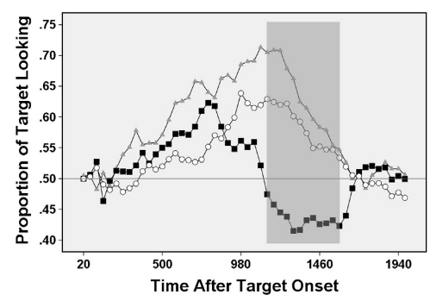
Influence of choices made for data analysis
Law & Edwards, 2015
Von Holzen & Mani, 2012
Growth Curve Analysis
Mirman et al., 2008
Cluster Based Permutation Analysis
Maris & Oostenveld, 2007
Notes:
Another option is Cluster Based Permutation Analysis, which captures where differences happen in time.

Slide 91
Theoretical insights
Mispronunciation sensitivity is robust
Does not change with age
Infants are sensitive to mispronunciation size
Mispronunciation sensitivity decreases with phoneme position in word
Similar sensitivity to consonant and vowel mispronunciations
Increases with age for vowel mispronunciations
Differences depending on language family
Notes:
Ok, to give a quick recap...

Slide 92
Theoretical insights
Mispronunciation sensitivity is robust
Does not change with age
Infants are sensitive to mispronunciation size
Mispronunciation sensitivity decreases with phoneme position in word
Similar sensitivity to consonant and vowel mispronunciations
Increases with age for vowel mispronunciations
Differences depending on language family
Why no developmental change?
Early specificity
Might be due to differences in data analysis approach
Wash out developmental effects

Slide 93
Theoretical insights
Mispronunciation sensitivity is robust
Does not change with age
Infants are sensitive to mispronunciation size
Mispronunciation sensitivity decreases with phoneme position in word
Similar sensitivity to consonant and vowel mispronunciations
Increases with age for vowel mispronunciations
Differences depending on language family
Why no developmental change?
Early specificity
Might be due to differences in data analysis approach
Wash out developmental effects
Influence of choices made for data analysis
Impact the conclusions we draw about developmental change

Slide 94
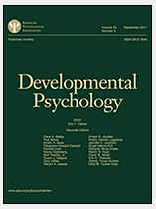



Thank you!
osf.io/nvc8m
Dr. Christina Bergmann
Student Assistant:
Emelyne
metalab.stanford.edu/
Accepted for publication
Preprint available!
psyarxiv.com/dze29

Slide 95
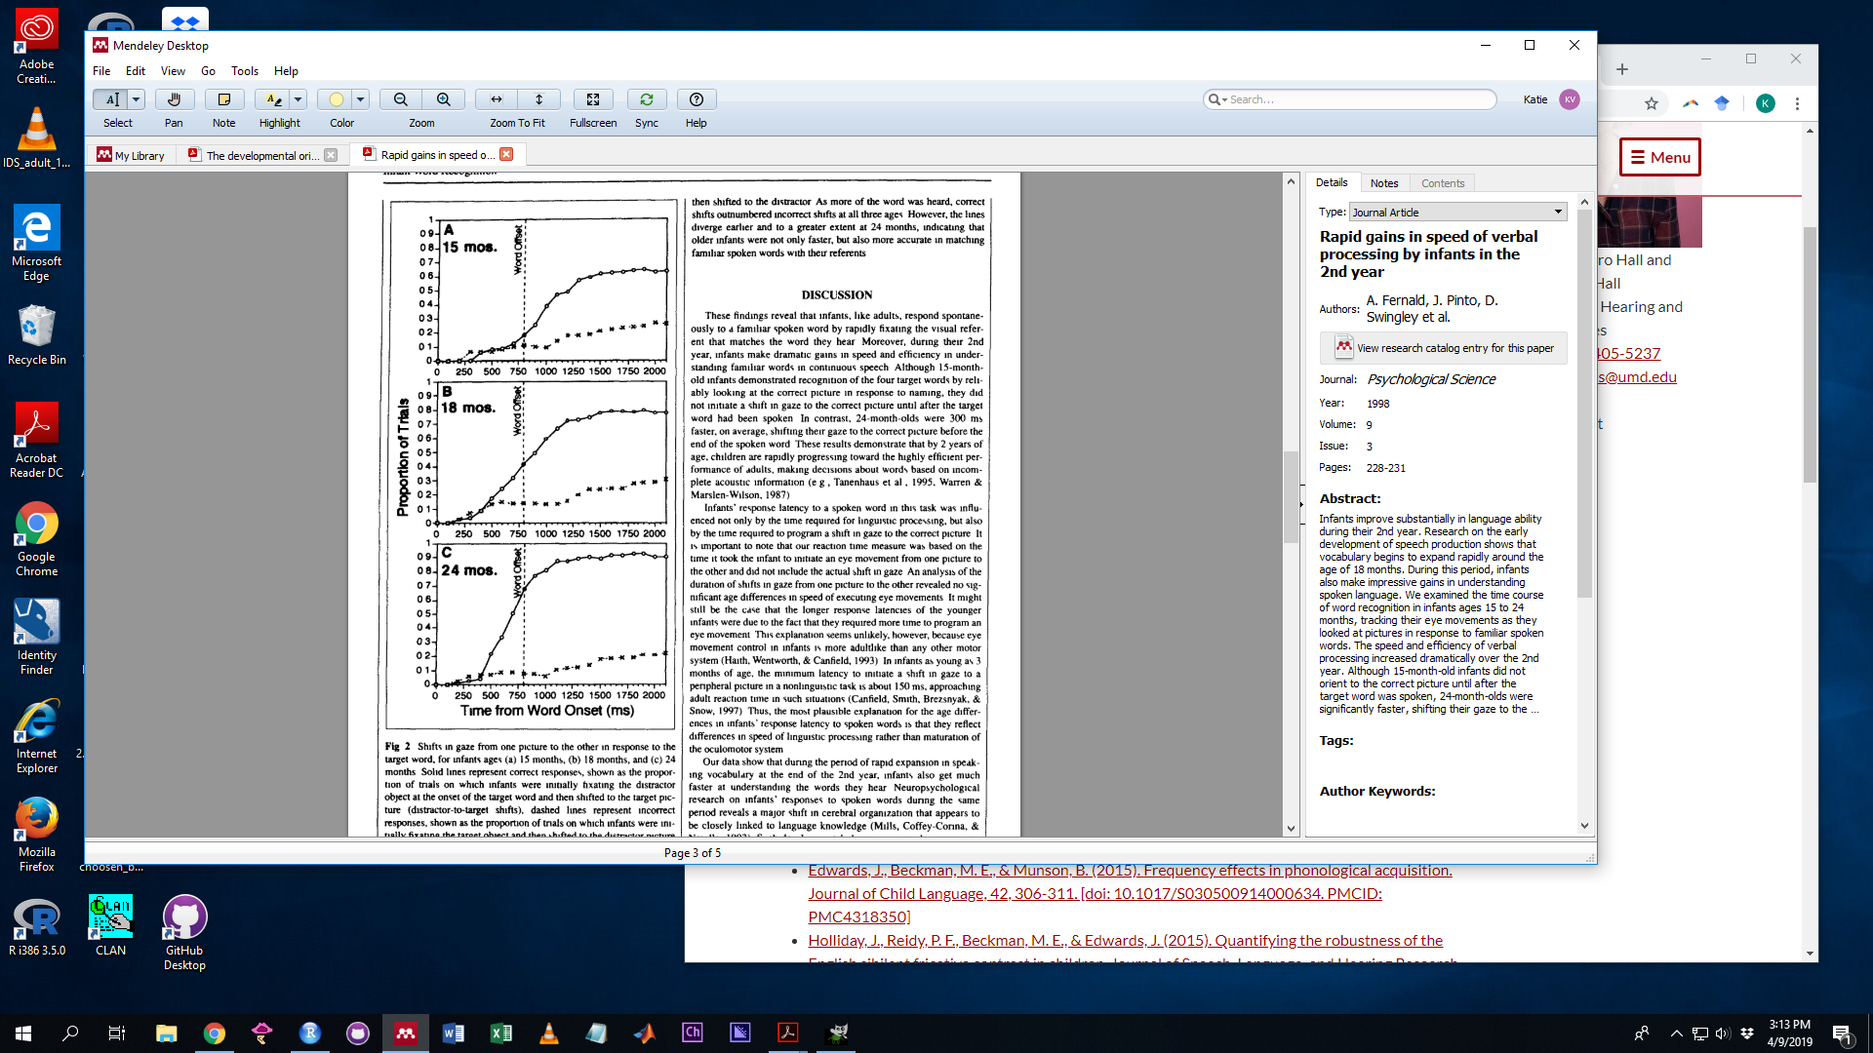
Adapted from Fernald et al., 1998
Notes:
This is a graph of how eye-movements to the target image change over time.

